Slide 1
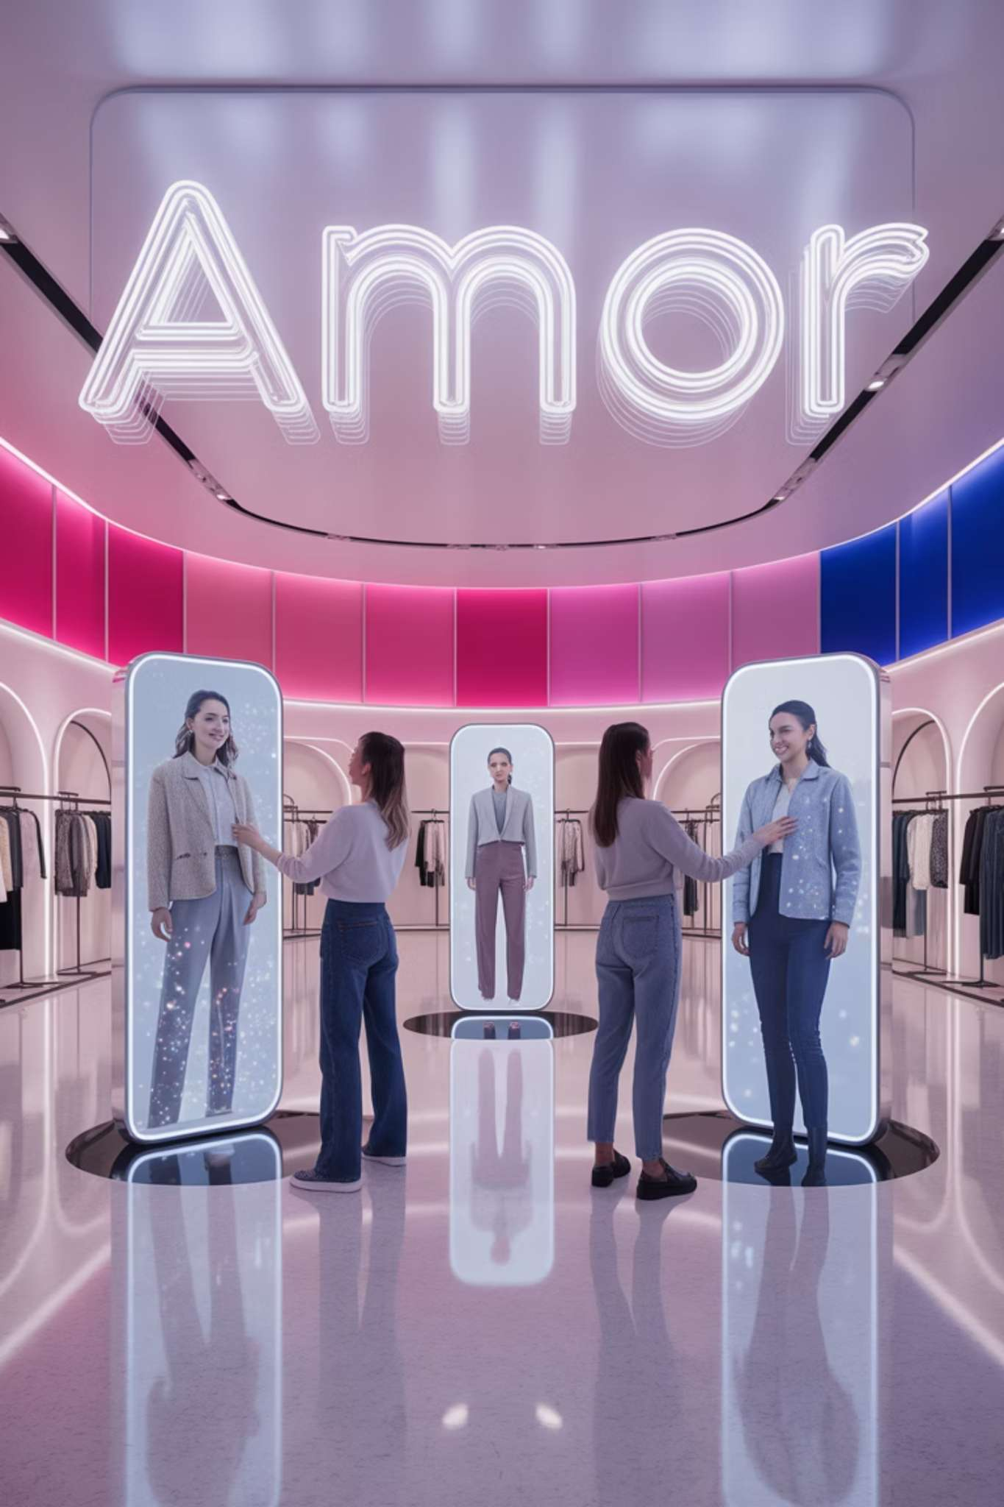
AI in Retail – Transforming the Shopping Experience
by Michael Garcia, Hashim Sayed Hoosini, Miguel Mora
Date: 07/02/2025
Course: ITAI 2372

Slide 2
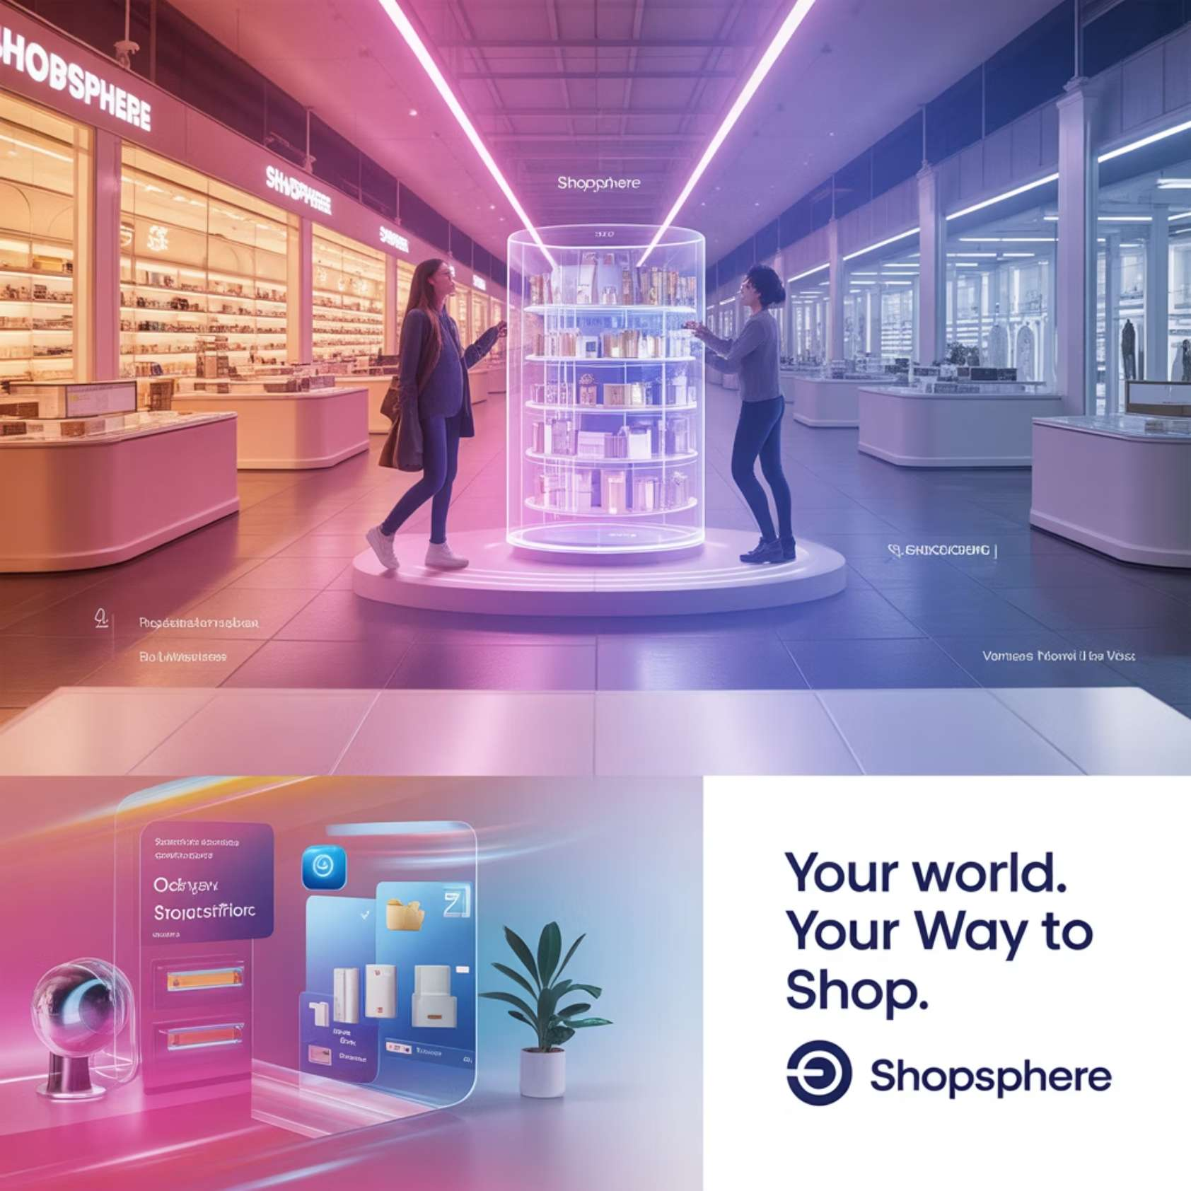
Introduction to Retail
Retail is the process of selling consumer goods or services to customers through multiple channels of distribution to earn a profit. Retailers satisfy demand identified through a supply chain.
The retail sector encompasses:
Brick-and-mortar stores
E-commerce platforms
Omnichannel retailers
Specialty stores
Department stores

Slide 3
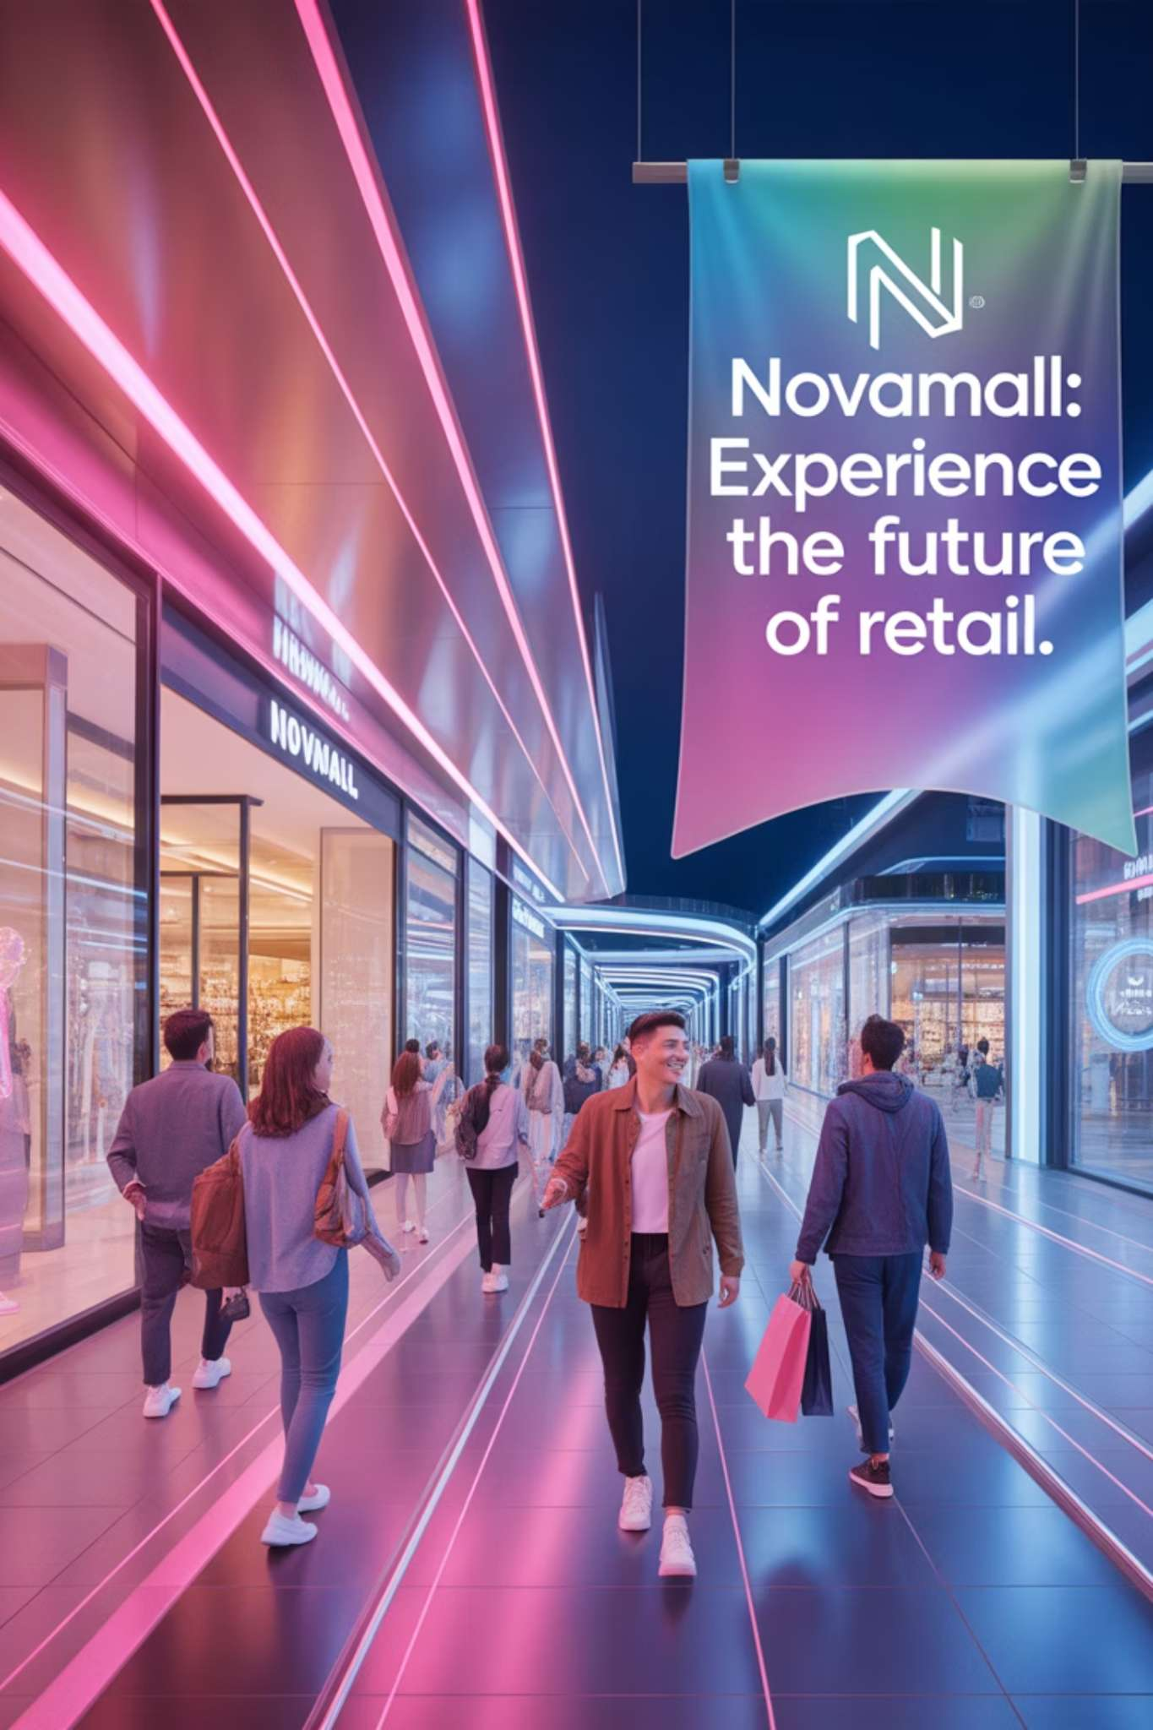
Domain Overview & Importance
What is the Retail industry?
The sector involved in selling consumer goods and services to customers through various distribution channels including physical stores and online platforms.
Importance of retail in the economy
Major employer, significant GDP contributor, drives consumer spending, and serves as a critical link between manufacturers and consumers.
Key challenges
High customer expectations, shrinking profit margins, fast-paced competition, and the need for constant innovation to stay relevant.

Slide 4
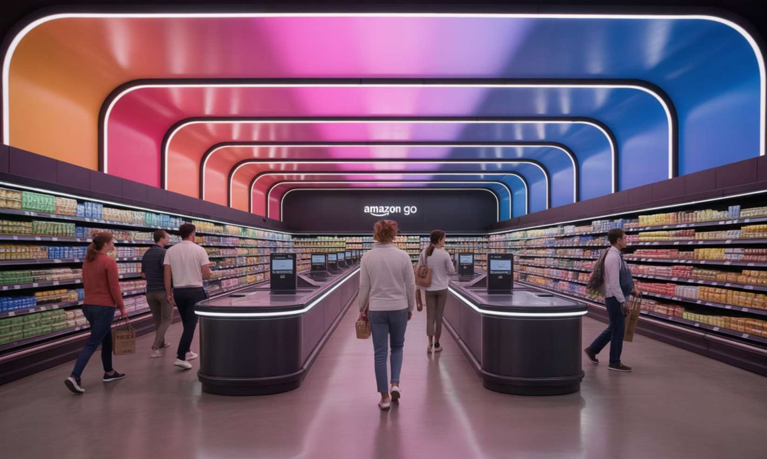
AI Use Case Motivation
What problems AI solves in retail
Inventory management inefficiencies
Customer service limitations
Personalization challenges
Supply chain optimization
Operational costs
Checkout friction
Real-world example: Amazon Go cashier-less stores
AI is essential for efficiency & customer experience by eliminating checkout lines, reducing labor costs, and providing seamless shopping experiences.

Slide 5
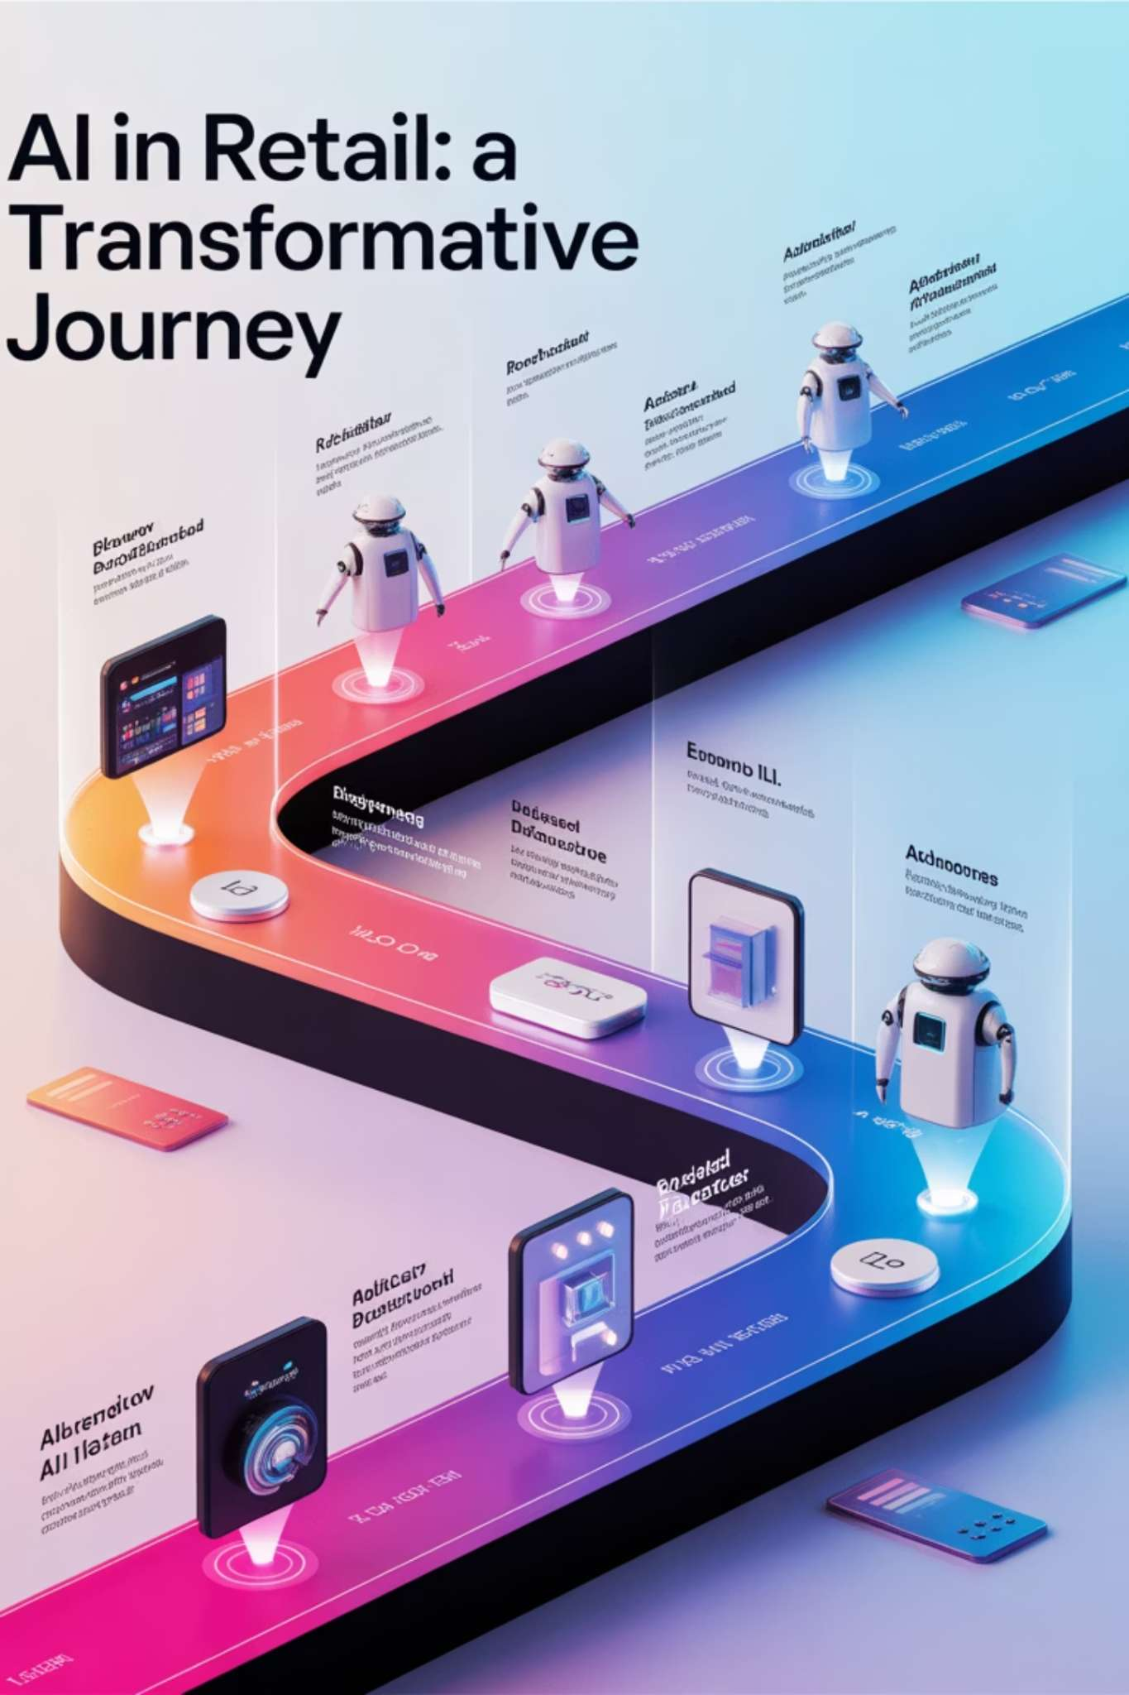




AI Techniques Used in Retail
Machine Learning
Powers demand prediction algorithms and dynamic pricing strategies based on historical data, market trends, and customer behavior.
Computer Vision
Enables shelf monitoring for inventory management, visual search capabilities, and cashier-less checkout systems.
NLP
Drives customer service chatbots, sentiment analysis from reviews, and feedback processing to improve products and services.
Robotics
Automates warehouse operations, inventory management, and in-store assistance to increase efficiency and reduce costs.

Slide 6
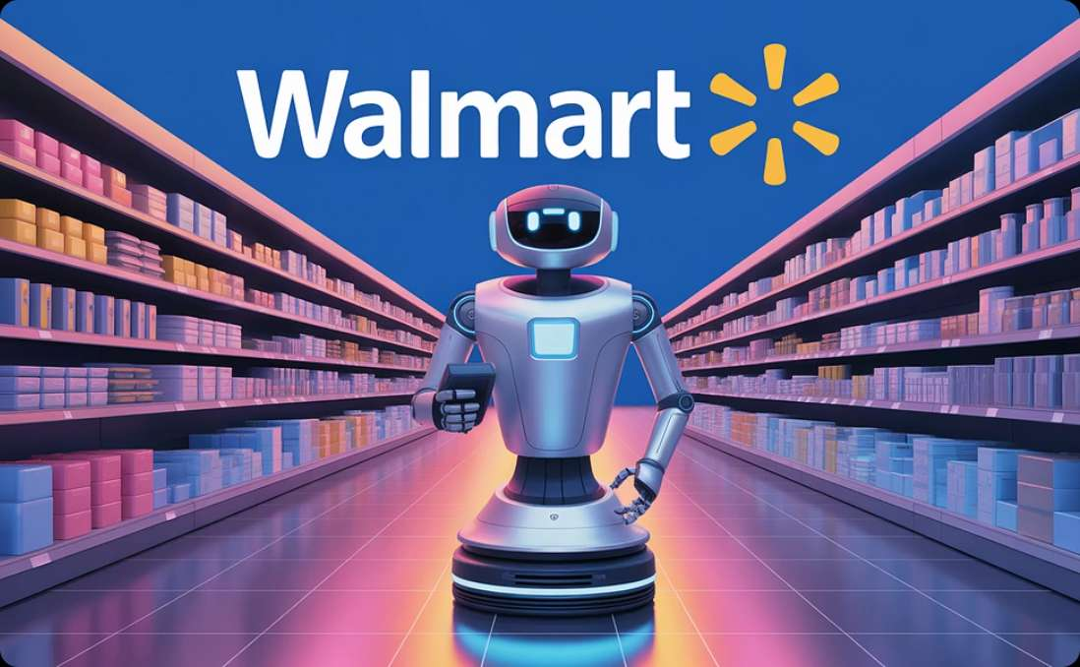
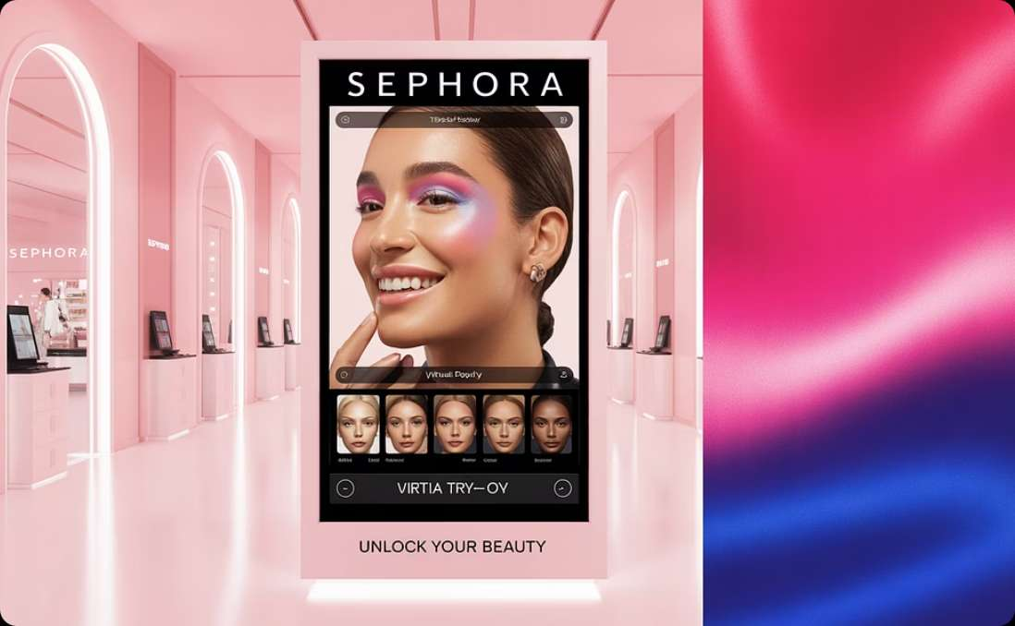
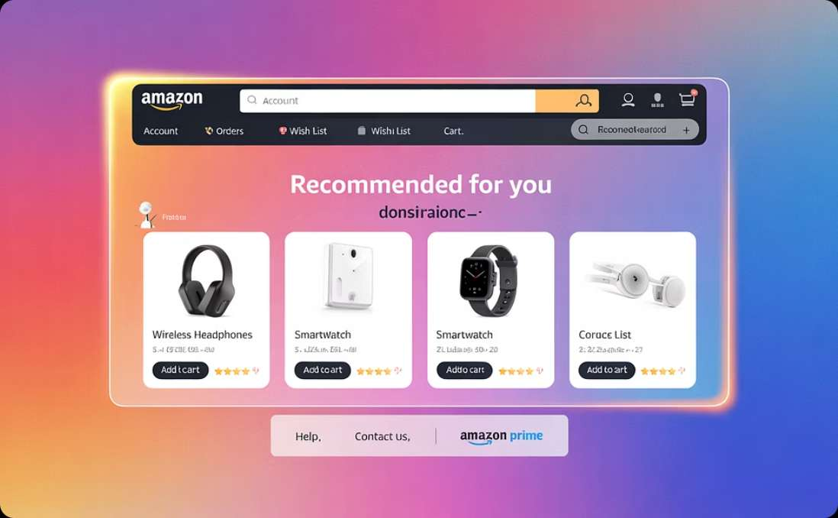
Key Applications (Case Studies)
Walmart: Shelf-Scanning Robots
Sephora: AI-Powered Virtual Try-On
Amazon: Personalized Recommendations
Automated robots scan shelves to identify out-of-stock items, misplaced products, and pricing errors.
AR technology allows customers to virtually test makeup products before purchasing.
ML algorithms analyze browsing history, purchases, and similar customer profiles to suggest relevant products.
ROI: 30% reduction in out-of-stock incidents, 90% improvement in inventory accuracy.
Efficiency: 11% increase in conversion rates, 25% higher customer engagement.
ROI: 35% of sales generated through recommendation engine.

Slide 7
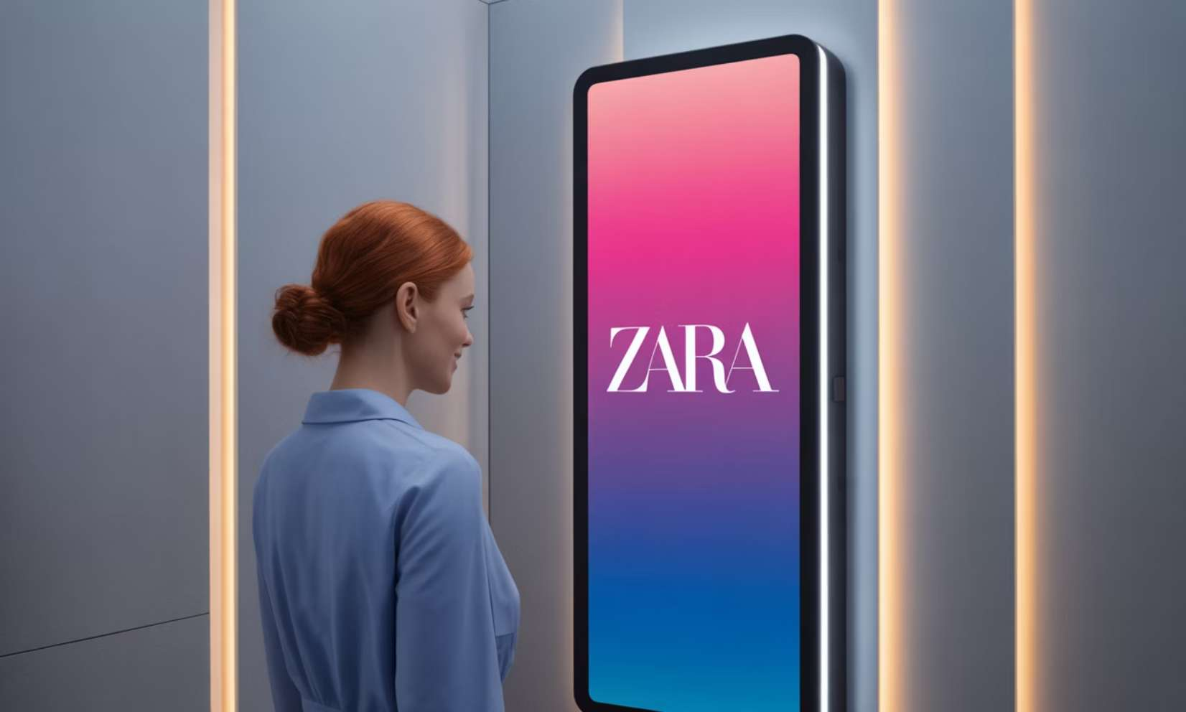
Personalization & Smart Technologies
Smart Retail Technologies
Smart shelves with digital price tags and inventory tracking
Dynamic pricing based on demand, time, and customer profiles
Personalized marketing through mobile apps and in-store beacons
Interactive mirrors for virtual try-on experiences
AR navigation to guide customers through stores
Examples:
Zara smart mirrors allow customers to see different outfit combinations without physically trying them on.
Amazon's recommendation system generates 35% of total company sales through personalized product suggestions.

Slide 8
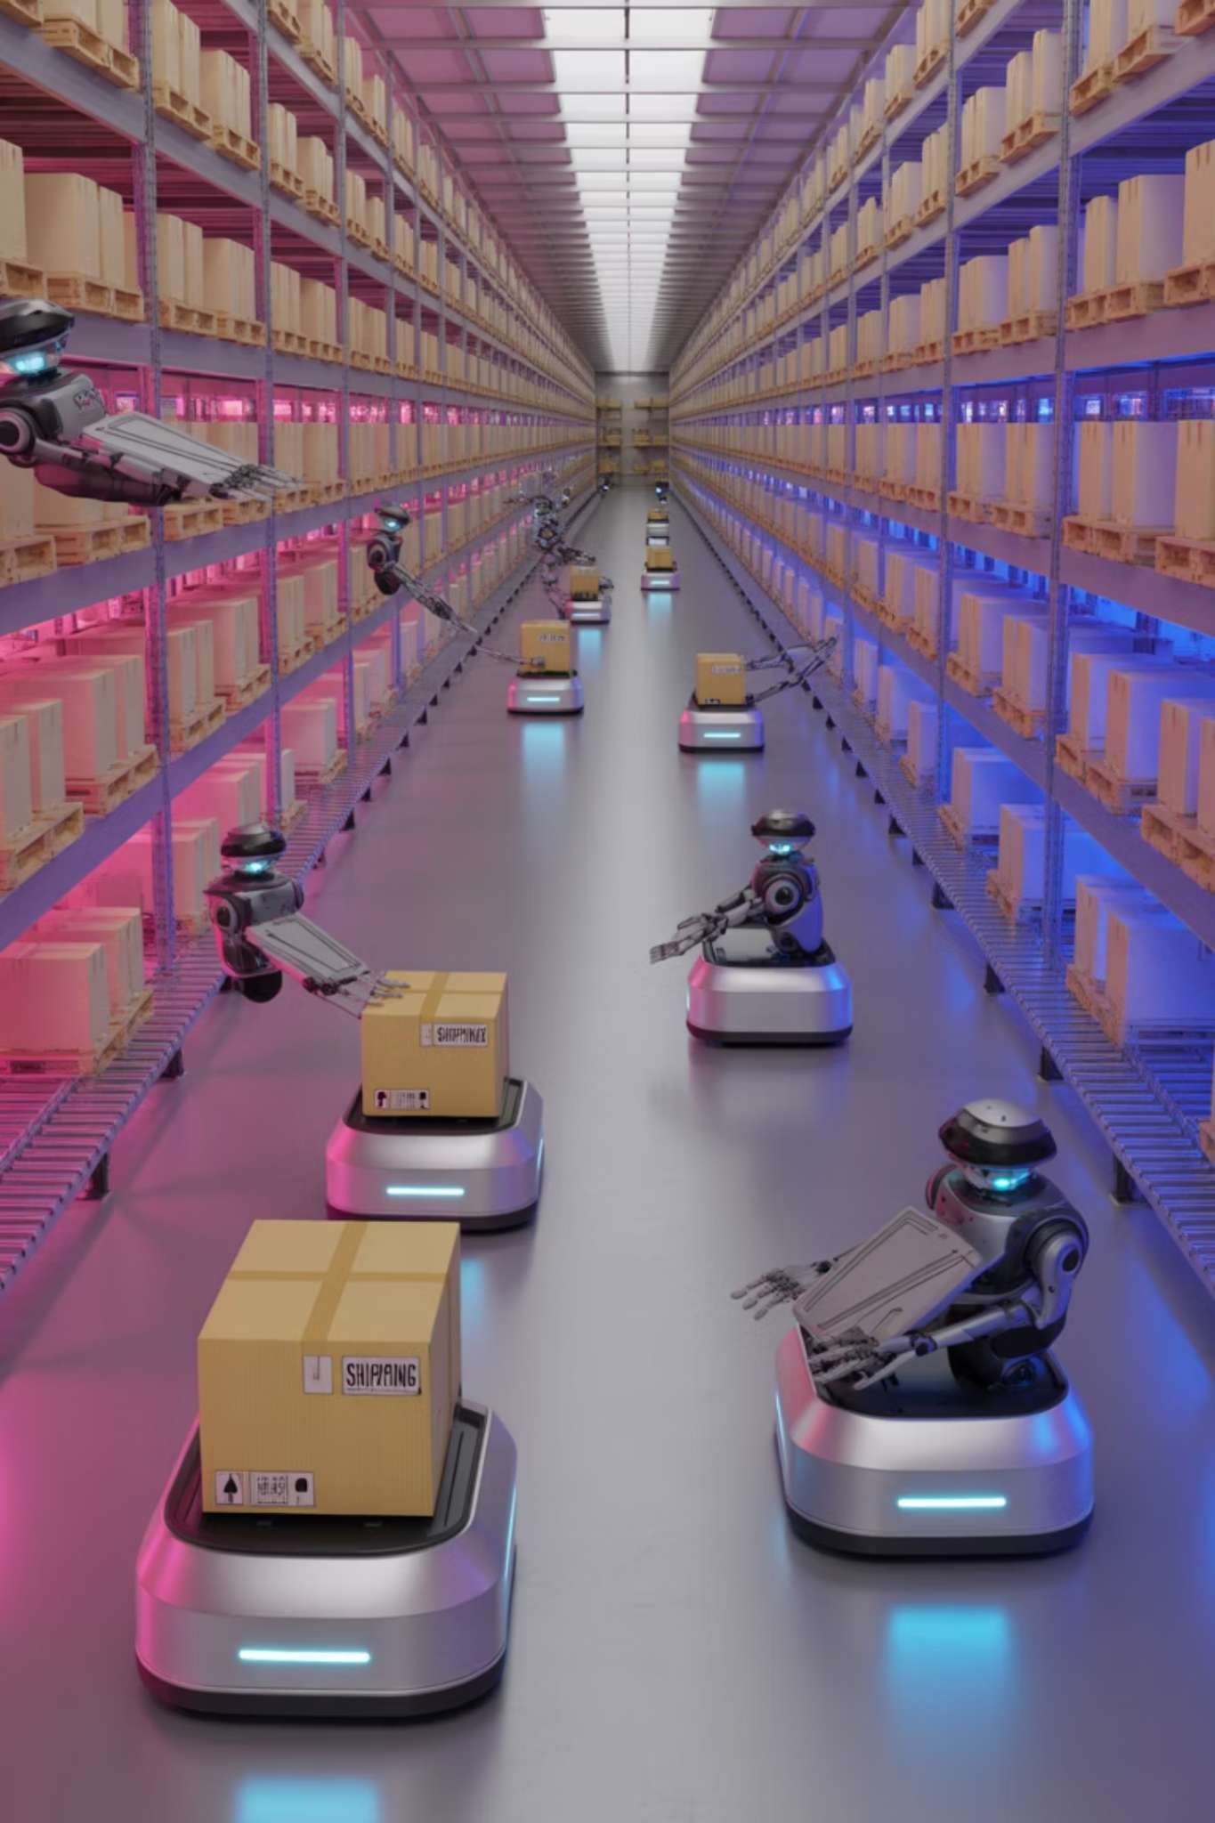



AI in Supply Chain & Warehousing
Forecasting Demand
AI analyzes historical sales data, market trends, weather patterns, and social media to predict future demand with up to 85% accuracy.
Inventory Optimization
Machine learning algorithms determine optimal stock levels, reducing overstock by 20-30% while preventing stockouts.
Robotics in Warehouses
Automated Guided Vehicles (AGVs), picking robots, and inventory drones increase fulfillment speed by 4x while reducing labor costs by 40%.

Slide 9
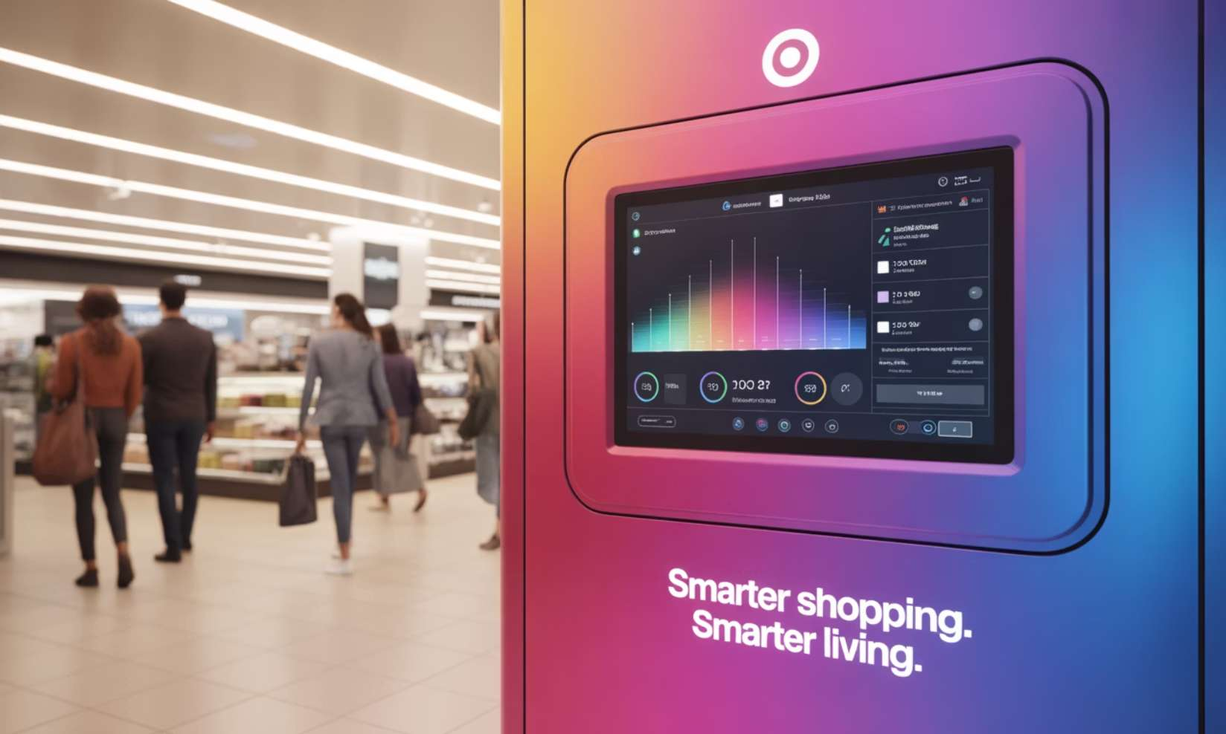
AI in Store Operations
Operational Applications
Staff scheduling based on predicted store traffic
Predictive maintenance for store equipment
AI-driven cleaning robots for store maintenance
Energy optimization systems that reduce consumption
Automated checkout systems
Loss prevention through anomaly detection
Real-life example:
Target's smart energy AI has reduced energy consumption by 15% across stores by optimizing HVAC systems, refrigeration units, and lighting based on store occupancy and external conditions.

Slide 10
Implementation Challenges
1
Data Quality
2
Legacy Integration
3
Change Management
Inconsistent, incomplete data
Connecting AI with outdated systems
Employee resistance to new technologies
4
Skill Gaps
Shortage of AI expertise in retail workforce
According to McKinsey (2022), 65% of retail AI implementations face significant challenges with data quality and availability, while 48% struggle with integration into existing systems.
Training and change management remain critical factors, with successful implementations investing 30% of project budgets in employee training and adoption programs.

Slide 11
Ethical Considerations
Key Ethical Challenges
Responsible AI Design Principles
Customer data privacy and consent for personalization
Privacy by design in all customer-facing systems
Bias in recommendation engines that may reinforce stereotypes
Regular bias audits of recommendation algorithms
Regulatory concerns around facial recognition in stores
Clear opt-in policies for data collection
Job displacement due to automation
Reskilling programs for affected employees
Transparency in AI-driven pricing decisions
Explainable AI for critical decision systems

Slide 12




Future Trends
Federated Learning
Edge AI in Retail
AI-driven AR Shopping
AI models trained across multiple devices while keeping customer data private, enabling personalization without compromising privacy.
Processing data locally on devices within stores, reducing latency and enabling real-time decision making for inventory and customer interactions.
Immersive experiences allowing customers to visualize products in their homes or on themselves before purchasing, increasing conversion rates.
Multimodal AI
Systems that combine vision, text, and voice recognition to create more intuitive and responsive shopping assistants and recommendation engines.

Slide 13
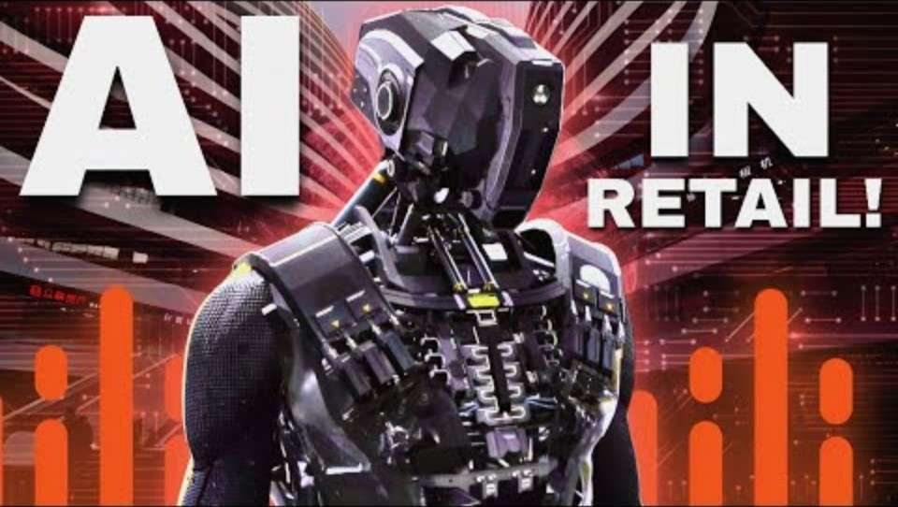
Interactive Demo

Slide 14
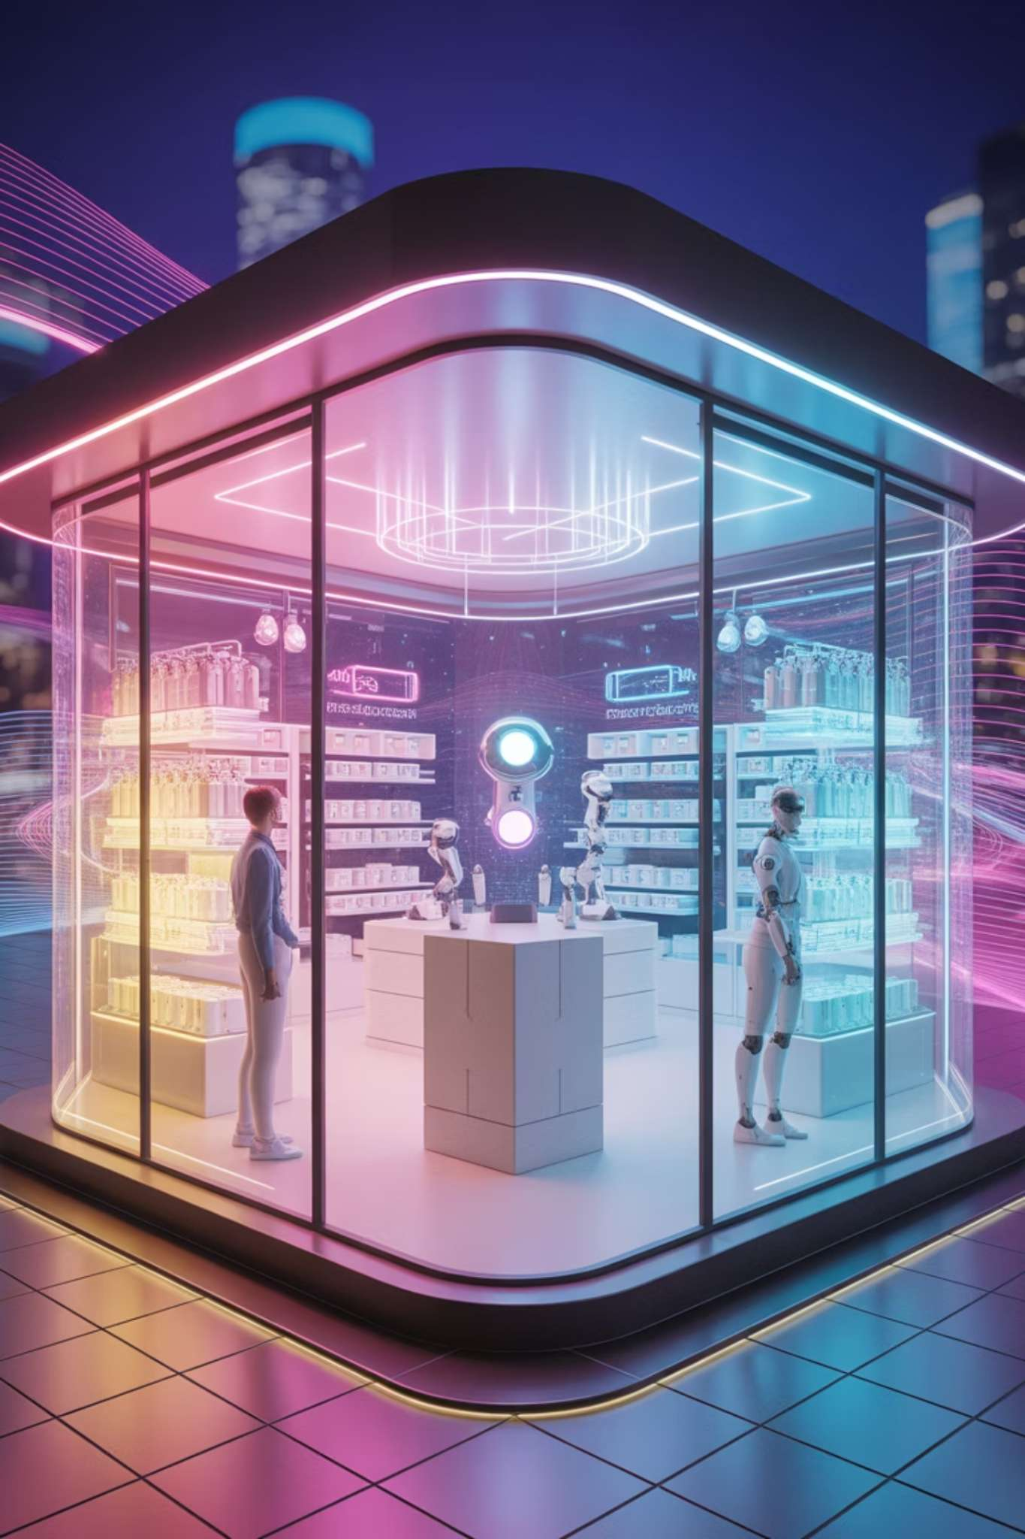
Conclusion
Customer Experience
AI enables hyper-personalization, frictionless shopping, and innovative experiences that meet rising customer expectations.
Operations
From supply chain to store management, AI optimizes every aspect of retail operations, reducing costs and improving efficiency.
Business Models
AI is enabling entirely new retail concepts and revenue streams that weren't possible before.

Slide 15
References
IBM. (2025). AI Fraud Detection in Banking. https://www.ibm.com/blog
Think Big Analytics. (2017). Danske Bank fights fraud with deep learning. http://www.thinkbiganalytics.com
McKinsey. (2022). The State of AI in Retail
Amazon Go, Walmart, Sephora, H&M, Target official websites

